Slide 1

Migrating to Azure Database for PostgreSQL
Submitted by:
Ezhilan Yugesh
Sharma Vinayak
Soni Yash

Slide 2

Introduction
Company “ACME” : Overview
Fast-Growing Tech Startup
Facing challenges with current on-premises PostgreSQL Database
Need for higher Availability, Scalability and Security

Slide 3
Current Database Challenges:
Increasing Data Volume due to user base growth and product expansion
Scalability problem which is a hindering performance
High Maintenance overhead and time-consuming administration tasks
Concerns about availability and security

Slide 4
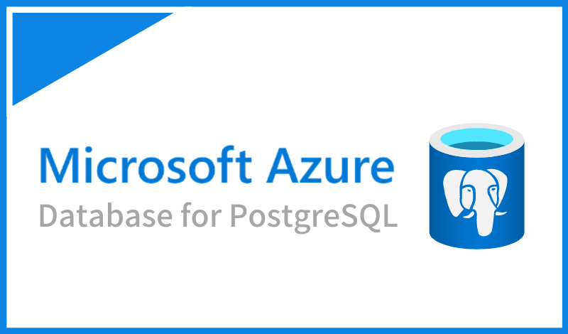
Solution Overview:
Azure Database for PostgreSQL
Cloud-based solution by Microsoft
Built on PostgreSQL
Offers advanced features and benefits

Slide 5

Benefits of Migrating to Azure Database for PostgreSQL

Slide 6
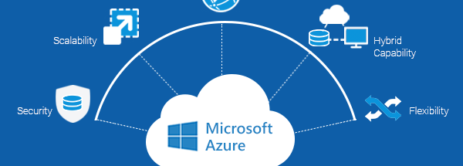
Ease of Use
User-Friendly platform
Supports Hybridization
Auditing - Collecting and examining information to determine proper use or misuse.
These are automatically written to log files by default or Azure Monitor.
This also helps maintain the Database easily at the organizational level.

Slide 7

Cost Saving:
Reduced infrastructure costs : no need for on-premises servers
Optimize IT resource utilization, freeing up developers for core product development
Eliminate time-consuming database administration tasks.

Slide 8

Scalability:
Seamless Scalability with Azure
Easily handle increasing data volume and application demands
Scale up or down as needed, ensuring optimal performance

Slide 9
High Availability:
Ensure continuous service with built-in redundancy and automated backups
Minimal downtime during maintenance or failures
Disaster recovery options and Geo-replication for added data protection

Slide 10
Enhanced Security:
Robust data encryption both in transit and at rest
Fine-grained access controls and role-based security
Certifications for industry standard (e.g., HIPAA, GDPR)

Slide 11
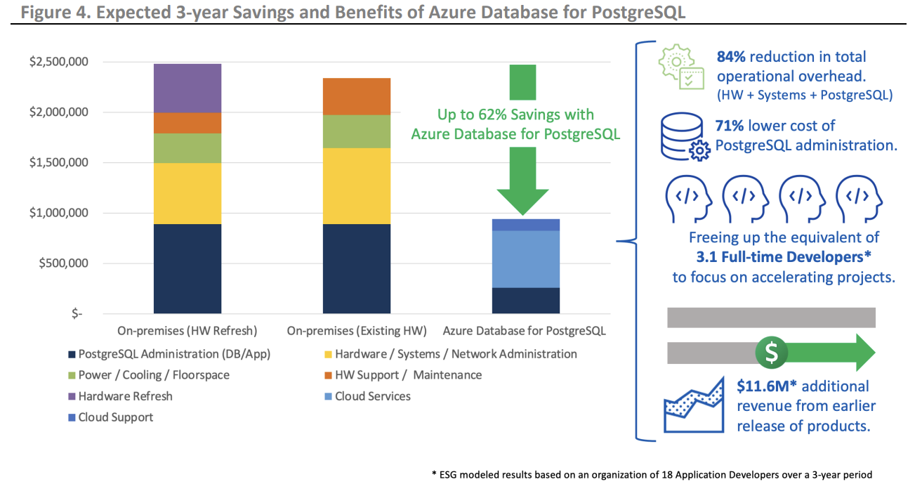
ROI - Analysis

Slide 12
Migration Strategy:
Assessment of current database and dependencies
Develop a migration plan with a deadline
Test migration on a non-production environment for validation

Slide 13
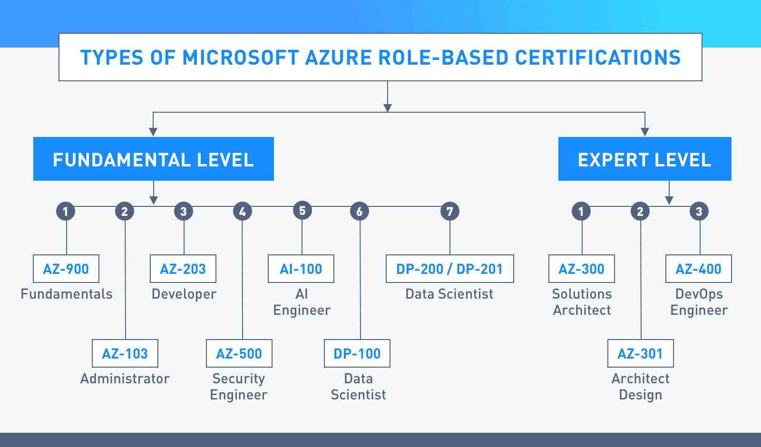
User Training:
Many Azure certifications are provided online.
Companies can directly recruit employees who obtain those certifications.
From an underlying assumption that Microsoft products are user friendly.
Also, the main Azure website provides whitepapers, and how-to-videos.
It will be easy for an organization to make it’s employees get familiar with Azure.

Slide 14

Conclusion:
Azure Database for PostgreSQL offers compelling benefits
Aligns with Company’s growth and strategic objectives

Slide 15

References:
Kaufmann, A., Duey, J. ( 2022, July). Analyzing the Economic Benefit of Migrating from On-Premises Instances to Azure Database for PostgreSQL. Enterprise Strategy Group. Retrieved from https://azure.microsoft.com/mediahandler/files/resourcefiles/analyzing-the-economic-benefit-of-migrating-from-on-premises-instances-to-azure-database-for-postgresql/ESG-Economic-Validation-Microsoft-Azure-Database-for-PostgreSQL-Jul-2022.pdf
Microsoft (2023). Tutorial: Migrate PostgreSQL to Azure Database for PostgreSQL online using DMS (classic) via the Azure portal. Retrieved from https://learn.microsoft.com/en-us/azure/dms/tutorial-postgresql-azure-postgresql-online-portal
Matherson, N. (2023, July 11). Postgres Performance Monitoring: Best Practices and Tools to Use. Hydra. Retrieved from https://www.hydra.so/blog-posts/2022-08-08-postgres-performance-monitoring-best-practices-and-tools
This Photo by Unknown author is licensed under CC BY-SA.

Slide 16

Thank you Any Questions?

